Slide 1

Assessment 2c:
Project title: IoT Health Monitoring System
for Children with Febrile Convulsions
IFN649 Advanced Networks
Rehab Dahan
N11387963

Slide 2
project overview
What the Project Will Do:
ItIt is a new health monitoring system has been designed specially to help children who're prone to febrile seizures by using IoT technology .It uniquely combines temperature, heart rate, and fall detection sensors in one device, providing real-time monitoring and alerting through CloudWatch dashboard. An audible alarm is triggered by use Buzzer if the child's temperature rises above a specified threshold.
How will this be done?
Data will be collected from sensors using a Teensy microcontroller that is linked to temperature sensor and heartbeat sensor and shock sensor well. The data will be sent over Bluetooth to a Raspberry Pi device which will prosses data such, as checking for any breaches in thresholds before forwarding the data to AWS IoT Core for long-term tracking and trigger audible alarm if abnormal conditions are detected. The system will display real-time data on the dashboard for caregivers to monitor the child’s health status.
Why It Is Important:
This project introduces an innovative method to tackle a critical health issue by detecting and preventing febrile seizures in children early on. The integration of multiple sensors into a single system ensures comprehensive health monitoring, while the web-based dashboard allows caregivers to monitor real-time health data from anywhere, ensuring rapid intervention during health emergencies.

Slide 3
Tier 1 Design (Sensing Tier)
Sensors and actuator Used:
Temperature Sensor (DS18B20): Monitors the child's body temperature and alerts are sent it exceeds 38°C. It connected to the Teensy on digital pin.
Heartbeat Sensor (ARD2-2239): Continuously monitors the child's heart rate. Alerts are sent if heart rate exceeds or drops below safe levels (60-120 BPM). It connected to the Teensy is on analog pin A0.
Shock Sensor: Detects sudden movement or falls, indicating a possible convulsion or emergency. . It connected to the Teensy on digital pin.
actuator (Buzzer) to produce alerts, if the temperature exceeds 38°C.
Teensy Microcontroller: All sensors are connected to the Teensy, which doing:
Reading sensor data from all sensors.
Sending sensors data to Raspberry Pi via Bluetooth.
Receiving commands from Raspberry Pi to control the buzzer.
Implementation: Data from sensors is read using the Teensy microcontroller, which collects and sends the sensor data over Bluetooth to the Raspberry Pi.

Slide 4
Tier 2 Design (Edge Tier)
Bluetooth Communication: Data is transmitted wirelessly from the Teensy to the Raspberry Pi using a Bluetooth module (HC-05).
Data Preprocessing: The Raspberry Pi acts as the central processing unit and does the following:
Receive data via Bluetooth from Teensy.
The Raspberry Pi checks for any threshold breaches (e.g., high temperature, abnormal heart rate, or shock).
Log data to a CSV file.
Publish sensor data to an AWS MQTT broker.
Subscribe to an MQTT topic for receiving control commands from the cloud.
Send control commands (e.g., activating or deactivating the buzzer) to Teensy via Bluetooth based on received MQTT messages.
Alert System: If any abnormal values are detected, the Raspberry Pi triggers an alert based on received MQTT messages and forwards the processed data to AWS IoT Core via MQTT.

Slide 5
Tier 3 Design (Cloud Tier)
Cloud Integration:
Data is sent from the Raspberry Pi to AWS IoT Core using MQTT for real-time monitoring and alerting.
AWS IoT Core enables seamless communication between IoT devices and cloud services for continuous monitoring.
downstream communication is used when AWS sends a command to activate the buzzer (via MQTT) when thresholds are breached, the Raspberry Pi processes that command and sends it to the Teensy through Bluetooth, ensuring instant notification of health abnormalities.
User Interface:
Caregivers can monitor health data through CloudWatch dashboard, which provides real-time data visualization and alerts.
The dashboard is hosted on AWS service (CloudWatch), allowing easy access from any device with a web browser.
AWS IoT Core triggers alerts when thresholds are breached, and these alerts are displayed directly on the dashboard for immediate caregiver awareness.

Slide 6
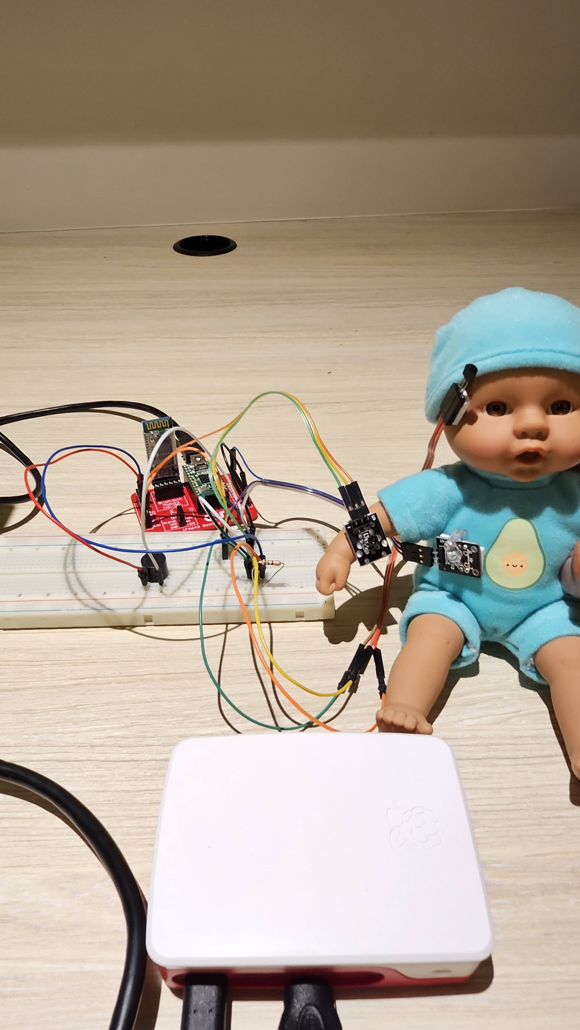
The project configuration
Bluetooth (HC-05)
Temperature Sensor (DS18B20)
Teensy microcontroller
Shock Sensor
full breadboard
Heartbeat Sensor (ARD2-2239)
Buzzer
Raspberry Pi + SD card

Slide 7
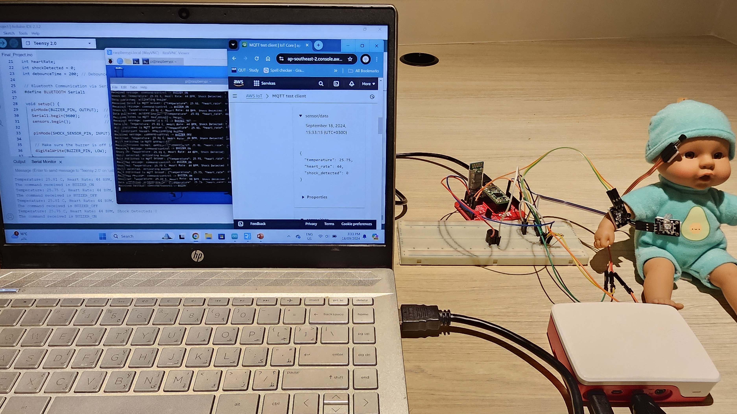
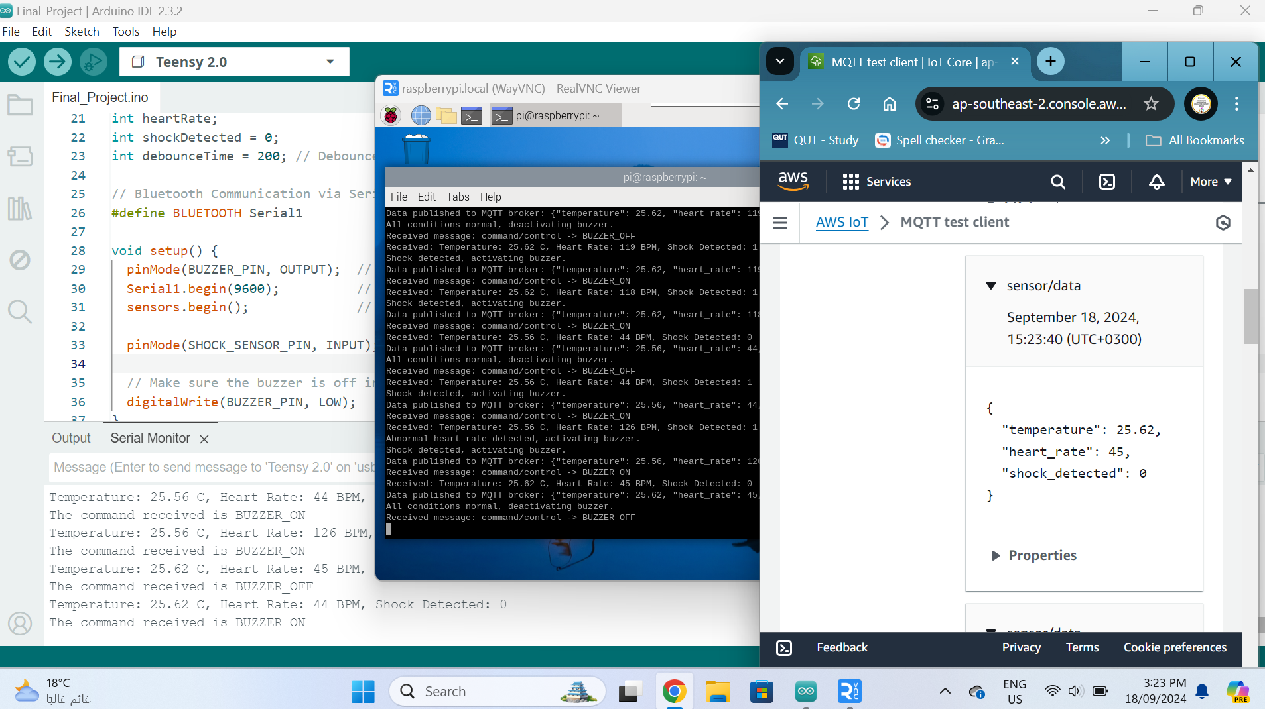
The project configuration
The image shows Teensy send sensor data to Raspberry Pi connected to AWS IoT Core, receiving and publishing sensor data via MQTT , with the output displayed on the Raspberry Pi's terminal and the AWS IoT Core MQTT test client.

Slide 8
Design considerations for the project
Indoor vs Outdoor Deployment:
The system is designed for indoor deployment, considering that the monitored environment will be a controlled space (home or hospital), requiring reliable Bluetooth and Wi-Fi communication.
Number of Devices:
The system incorporates three main sensors (temperature, heart rate, and shock) communicating with a Raspberry Pi for data preprocessing and alerting. Additionally, any device with a web browser to show the dashboard hosted on AWS services.
Power Source:
Raspberry Pi and the sensors are socket-powered for continuous monitoring, ensuring reliability in data collection without battery concerns.
Network Requirements:
- The system uses short-range Bluetooth for communication between the Teensy and Raspberry Pi, and Wi-Fi for cloud connectivity (AWS IoT Core).
- The data rate is low, handling temperature, heartbeat, and shock sensor data.
- Latency considerations ensure real-time alerts, which is crucial for health monitoring.
Deployment Cost:
Low-cost components such as the Teensy, Raspberry Pi, and sensors make the system affordable, with scalable options for real-world deployment, while AWS services provide scalable cloud support.
Sensitive Data (Privacy and Security):
Data privacy is ensured through encryption and cloud-based security protocols, given the sensitivity of health data, particularly for children.
Security (Device, Network, and Data):
- Device security ensures the sensors and microcontrollers are tamper-resistant.
- Network security is implemented using encryption protocols (SSL/TLS) for wireless communication between the Raspberry Pi and AWS IoT Core.
- Data security ensures that sensitive health information is protected in storage (AWS) and during transmission. by Access Control, authentication mechanisms are in place to ensure only authorized devices can access the data.

Slide 9
methodology
Setup Sensing Tier: Connect the temperature sensor, heart rate sensor, and shock sensor and test them on the Teensy microcontroller to make sure they are working properly.
Bluetooth Communication: Set up Bluetooth communication between Teensy and Raspberry Pi for sensor data transfer.
Data Preprocessing on Raspberry Pi: Process incoming sensor data on the Raspberry Pi such as, check for threshold breaches (e.g., high temperature, abnormal heart rate), and trigger alerts via MQTT if necessary.
Cloud Integration via AWS IoT Core: Forward the pre-processed data to AWS IoT Core using MQTT for real-time monitoring, logging, and data analysis.
CloudWatch Dashboard Setup: Develop the dashboard using AWS services to provide caregivers with real-time access to health data and alerts from anywhere, accessible via any device with internet access.
Testing and Calibration Process: Test and evaluate the system by using a doll to simulate real-world scenarios and ensuring alerts are triggered when certain limits are exceeded.
Final Integration: Ensuring all components (sensors, Raspberry Pi, cloud, and Web-Based Dashboard) are fully integrated and functioning smoothly to enable for real-time monitoring and alerts.

Slide 10
Github URL for source code:
https://github.com/Rehab1410/IFN649---Assessment-2c.git

